Slide 1

GOVERNMENT CONTRACT ANALYSIS AND AUTOMATED CURATION
PRODUCED BY:
EMILY ANDERSON
JORDAN GAITHER
MATTHEW VADEN
HUNTER WILSON
IN PARTNERSHIP WITH:
Notes:
James

Slide 2
INTRODUCTION

Slide 3
Overview
PeopleTec provides emerging technologies, engineering solutions, modeling and simulation, cybersecurity, and mission operations and program support services to the Department of Defense and Civilian Federal sectors.
Our team was given the opportunity to design methodologies that would optimize their contract selection process.
We analyzed previous contracts to create a model that would predict the open solicitations that PeopleTec would have a higher probability of winning. PeopleTec provided targeted North American Industry Classification System (NAICS) codes.
The contract information was gathered through the Federal Procurement Data System (FPDS), an open source repository that lists all federal contracts greater than $10,000.
From here we can combine these API-pulled files in Python giving us our base dataframe.

Slide 4
Objectives
Conduct exploratory data analysis; use derived metrics to verify current approach
Test models to confirm predictability; present metrics showing reliability
Provide probability scores attached to open contracts that PeopleTec can win

Slide 5
Assumptions
Data provided is limited open source data to maintain company and government confidentiality.

Slide 6
Project Deliverables
Verify/validate current statistical prediction methods
Design and develop improved prediction method(s)
Deliver prediction method(s) via report and code
Provide PeopleTec, Inc. with a working dashboard that displays open contracts segregated based on the working groups inside the company

Slide 7
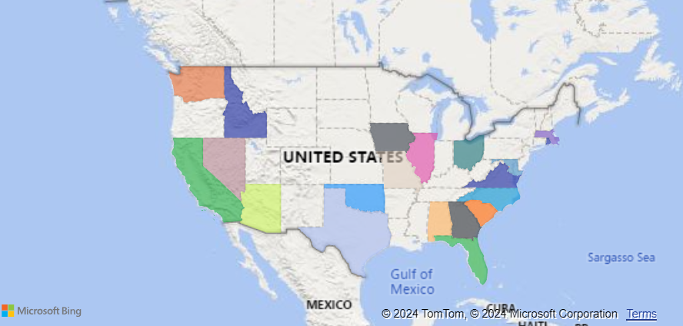
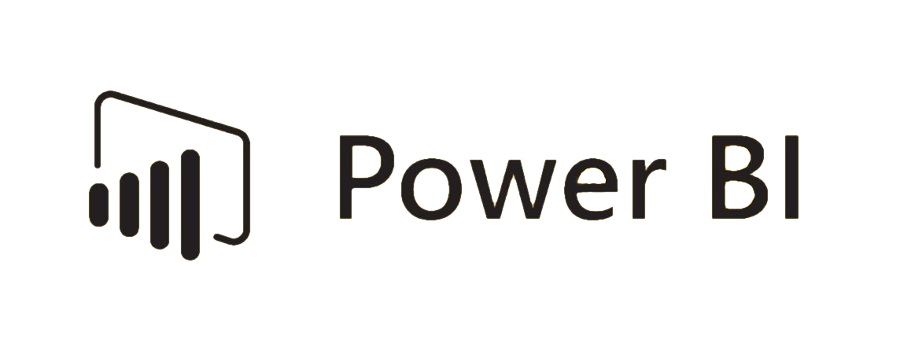
Dashboard
API pull directly from SAM.gov
Sorted by PeopleTec group
Interactive map for solicitations
Notes:
Delaney

Slide 8
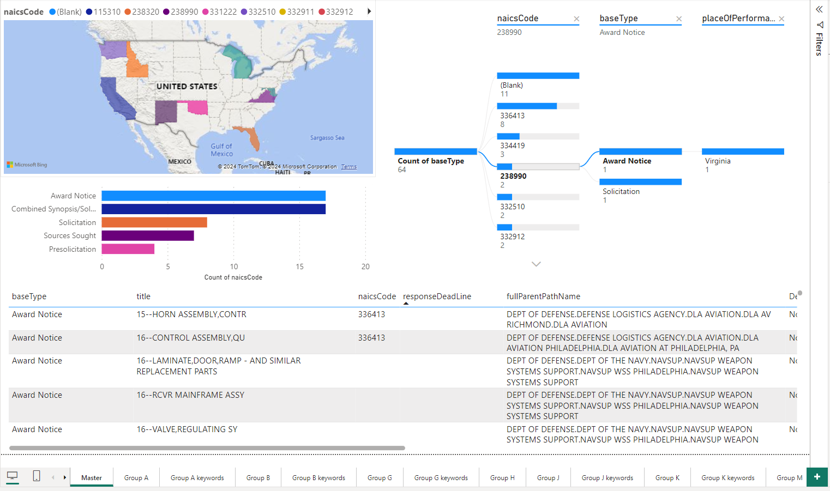
Dashboard - Overall
Notes:
Delaney

Slide 9
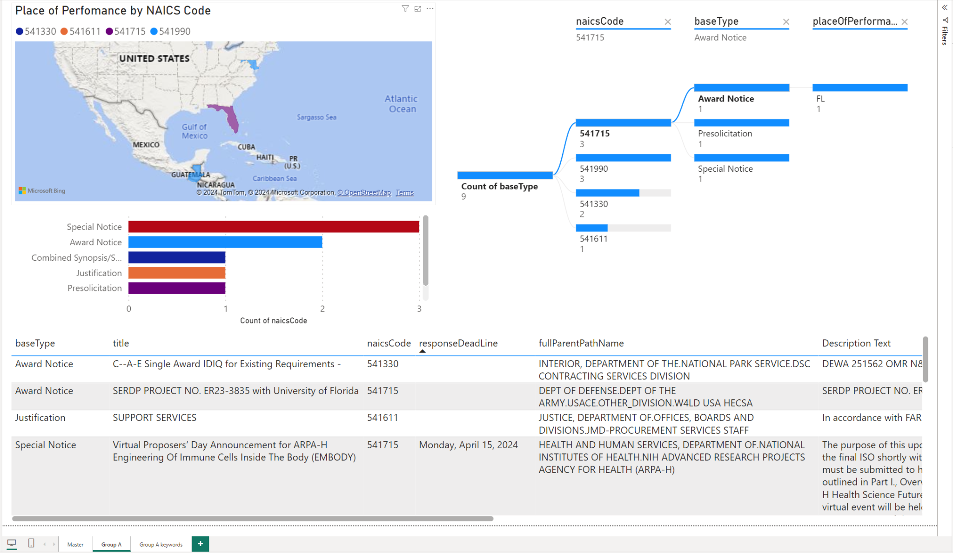
Dashboard - Group A
Notes:
Delaney

Slide 10
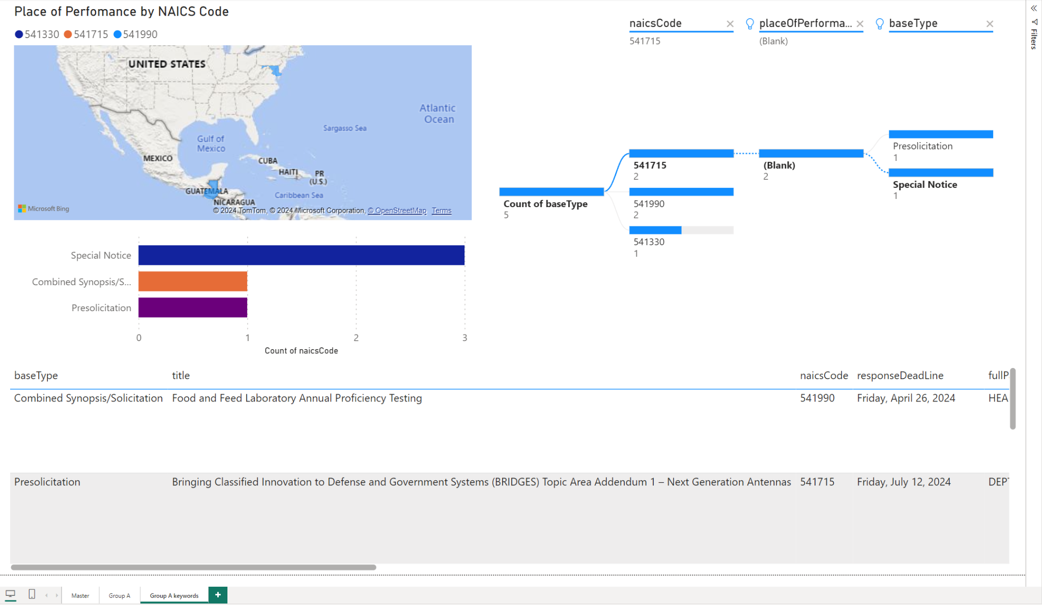
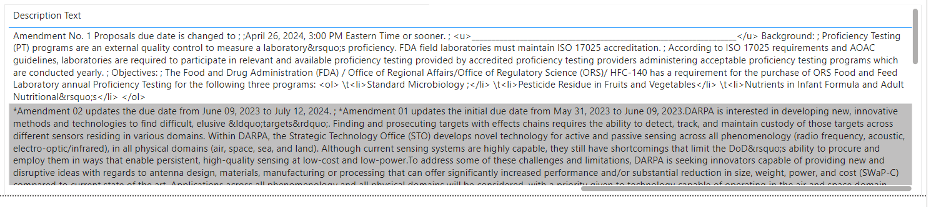
Dashboard - Group A (filtered)
Notes:
Delaney

Slide 11
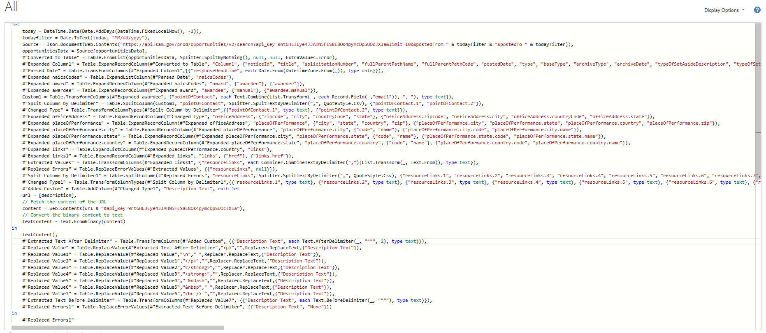
Dashboard Method
Notes:
Delaney

Slide 12
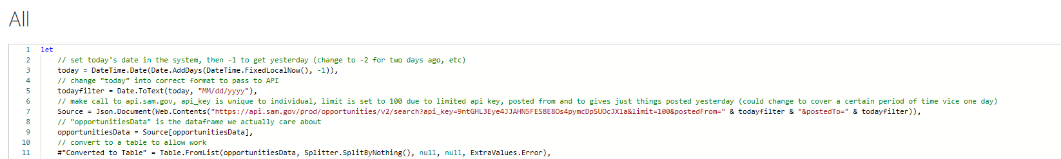
Dashboard Method
Notes:
Delaney

Slide 13
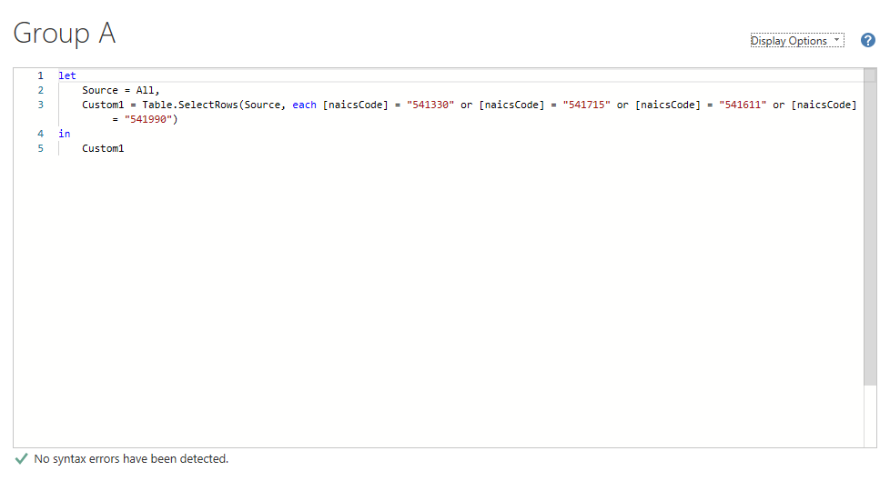
Dashboard Method - First Filter
Notes:
Delaney

Slide 14
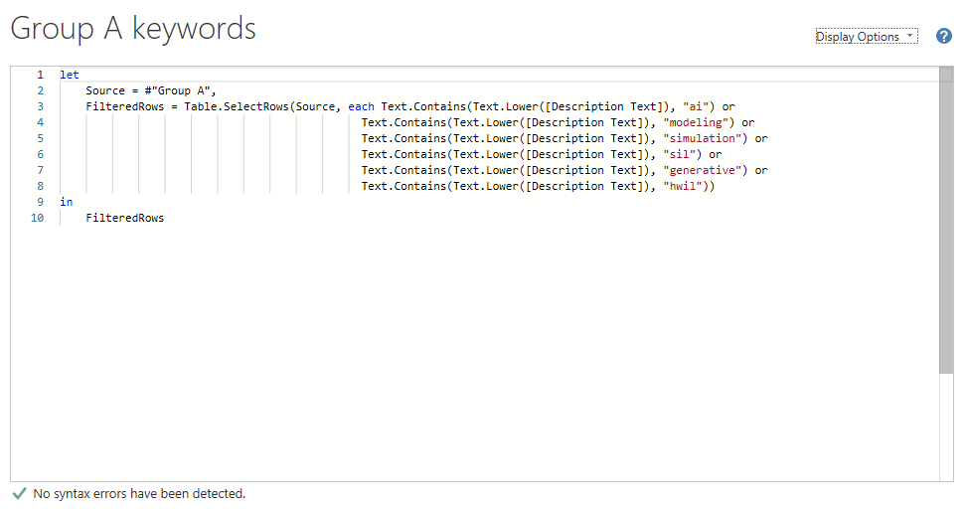
Dashboard Method - Keyword Filter
Notes:
Delaney

Slide 15
DATA DESCRIPTION AND EXPLORATION

Slide 16
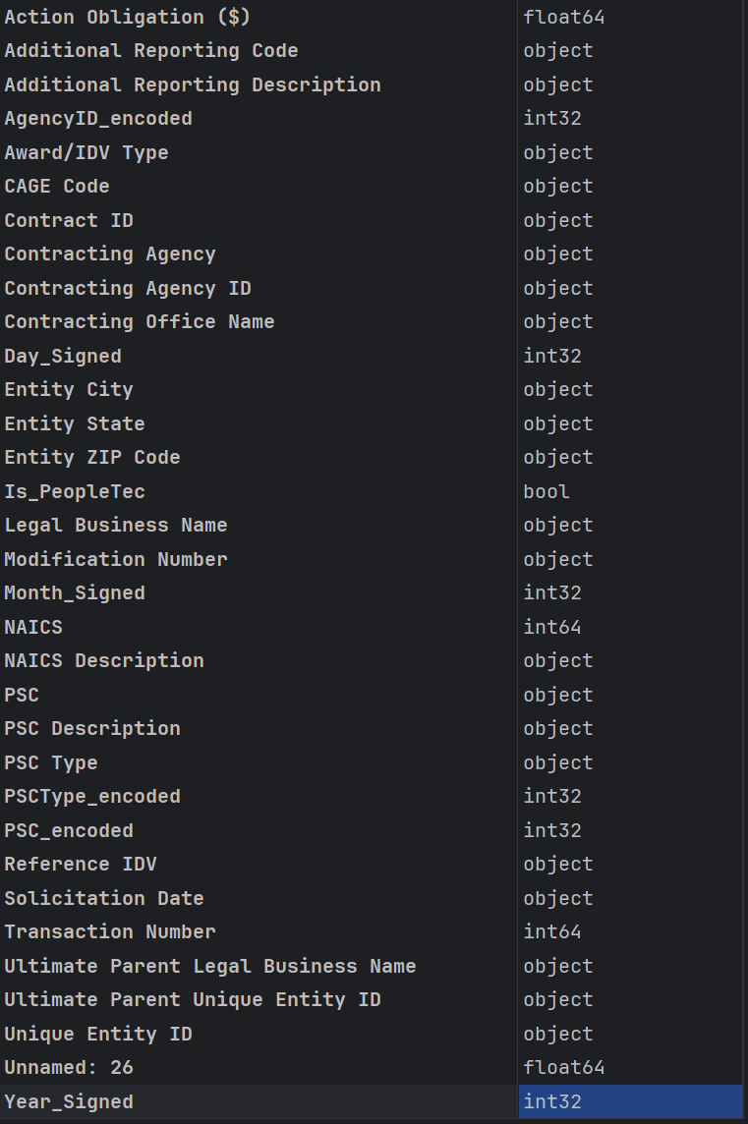
Considerations
Many variables were not relevant to whether or not PeopleTec would win the solicitation
5 primary variables were used

Slide 17
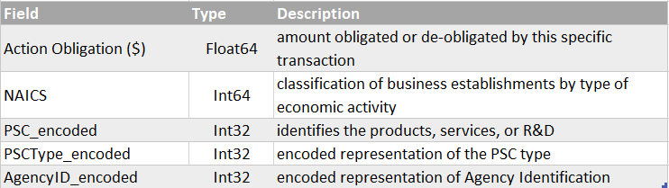
Data Description
FDPS

Slide 18
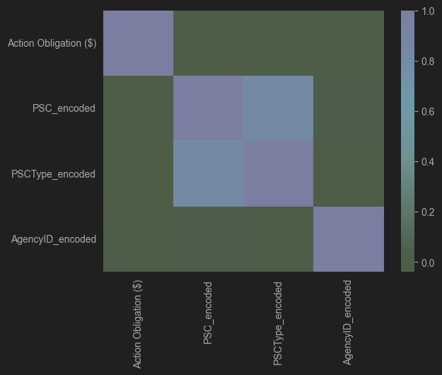
Correlation Heat Map
Notes:
(Matt) height and weight are highly correlated due to BMI being a calculation of the two

Slide 19
METHODS AND RESULTS

Slide 20
Feature Selection
Determine the relevant information for our models
Create binary variable by forming a column for the contracts with PeopleTec
Discovered 235 PeopleTec contracts, although many were unable to be used because they were from contracts prior to PeopleTec’s 2010 inception and the irrelevant data would skew results

Slide 21
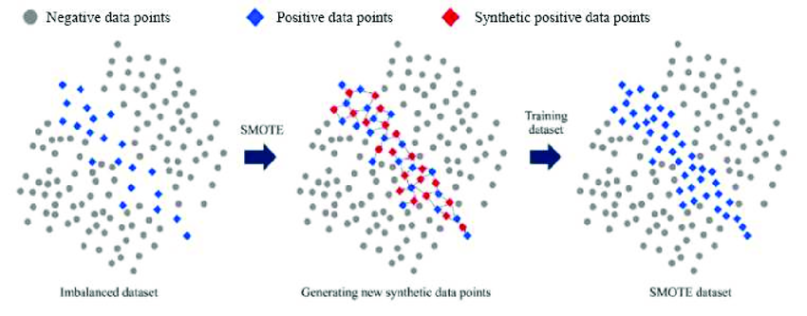
SMOTE
Synthetic Minority Oversampling Technique (SMOTE) corrects an imbalanced model using k nearest neighbors.

Slide 22

Chosen Models
Classification Tree
Random Forest
Gradient Boosting
Notes:
Delaney

Slide 23
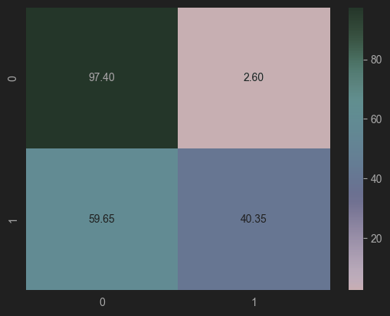
Classification Tree
Classifications trees are used for predictions of outcomes from a set of predictor variables and can help break down non-linear, complex relationships.
Confusion Matrix:
TP: 23
TN: 29589
FP: 789
FN: 34
Accuracy:
Test accuracy: 0.972958764580253
Notes:
Delaney

Slide 24
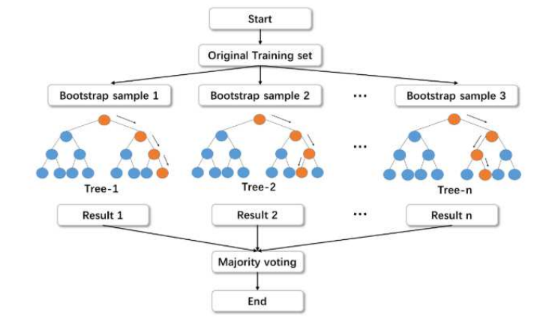
Random Forest
Random Forests group similar decision trees to create a “forest” to improve predictions and control over-fitting.
Confusion Matrix:
TP: 34
TN: 29551
FP: 827
FN: 23
Accuracy:
Test Accuracy: 0.9720716280597995
Notes:
Delaney

Slide 25
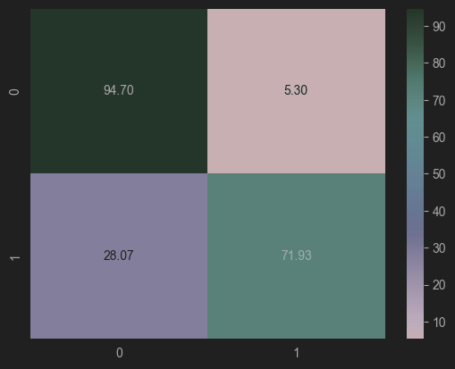
Gradient Boosting
Gradient Boosting works by iteratively training decision trees on the residuals of the previous tree. Each tree is trained to correct the errors of the previous tree, and the final prediction is made by summing the predictions of all the trees.
Classification Tree:
TP: 41
TN: 28768
FP: 1610
FN: 16
Accuracy:
Test Accuracy: 0.9465746673238048
Misclassification Rate: .053
Notes:
Nick

Slide 26
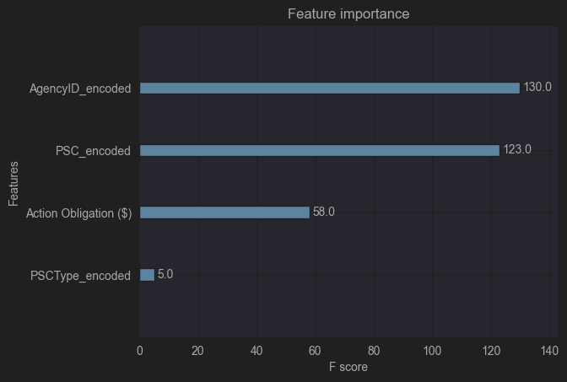
Gradient Boosting - Feature Importance
Notes:
Hongxia

Slide 27
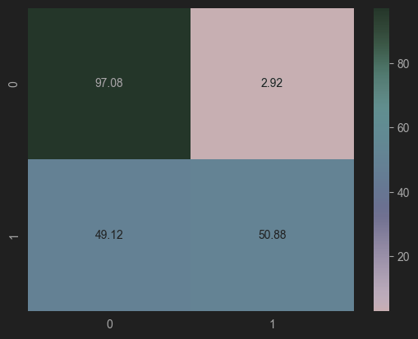
Gradient Boosting (Optimized)
Gradient Boosting (Optimized) trains and improves models by “boosting” predictive accuracy and minimizing error gradients changing the parameters using grid search.
Classification Tree:
TP: 30
TN: 29494
FP: 884
FN: 27
Accuracy:
Test Accuracy: 0.9700673566617382
Notes:
Nick

Slide 28
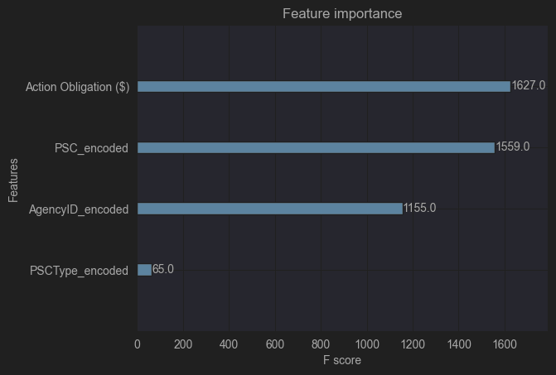
Gradient Boosting (Optimized) - Feature Importance
Notes:
Hongxia

Slide 29
Interpretation
Our best models are the standard XGboost model and Random Forest Classifier. Although other models possess a higher accuracy then the XGBoost the decrease in recall scores hurt the models, reliability.
XGBoost has the best recall score without a large number of false positives (however larger than many of the other models).
The Random Forest model cuts the number of false positives in half, while only missing 7 more of PeopleTec’s 57 total contracts.
This tradeoff allows both models to be useful predictors and with further feature selection and optimization we could see both models significantly increasing performance.

Slide 30
Recommendations
One of our variables is Action Obligation. This variable however is not present in open contracts therefore it can’t be used for predicting open contracts. However, this variable could be created if a contract description is available. By analyzing contract descriptions against previous contracts action obligation can be predicted allowing the open contracts to be predicted with good accuracy.

Slide 31
Conclusion
Model | Accuracy
Classification Tree | 0.972959
(Opt.) Random Forest | 0.972072
Gradient Boosting | 0.946575
Opt. Gradient Boosting | 0.970067
Notes:
James

